Slide 1

Storage Management
Mass Storage Structure
I/O Systems

Slide 2
Mass Storage Structure Chapter 11
Disk Structure
Disk Scheduling

Slide 3
Secondary (Mass) Storage Structure
Disk drives and NVM devices are the major secondary storage I/O devices on most computers
These are structured as a large one-dimensional array of logical disk blocks
Request for disk I/O is generated by the file system and virtual memory system
Disk scheduling algorithms are used to improve the disk bandwidth, average response time and the variance in response time
FCFS, SCAN, C-SCAN are some of the commonly used disk scheduling algorithms
Swap space provides an efficient interface to paging systems
Disks can suffer from external fragmentation

Slide 4
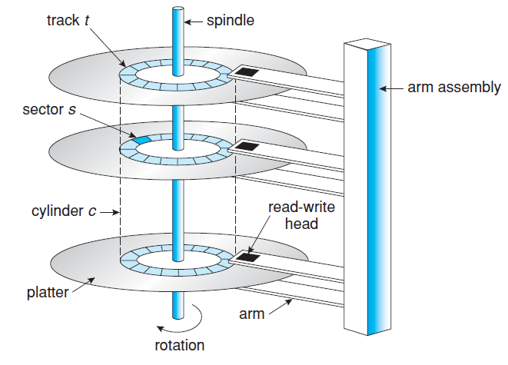
Moving-head disk mechanism

Slide 5
Disk Scheduling
Access time components
Seek time and rotational latency
Seek time is the time for the disk arm to move the heads to the cylinder containing the desired sector
Rotational latency is the additional time for the disk to rotate the desired sector to the disk head
Bandwidth is the total number of bytes transferred divided by the total time
Both access time and bandwidth can be improved by managing the order in which disk I/O requests are serviced

Slide 6
Disk Scheduling
Disk queue may have several pending requests at any point in time
Any one of the several disk scheduling algorithms can be used
Access time and bandwidth can be improved by managing the order of disk I/O requests
FCFS Scheduling
Fair algorithm but does not provide fastest service
I/O requests to blocks on cylinders – initial head position is 53
98, 183, 37, 122, 14, 124, 65, 67
Total head movement is 640 cylinders
Total head movement can be decreased substantially

Slide 7
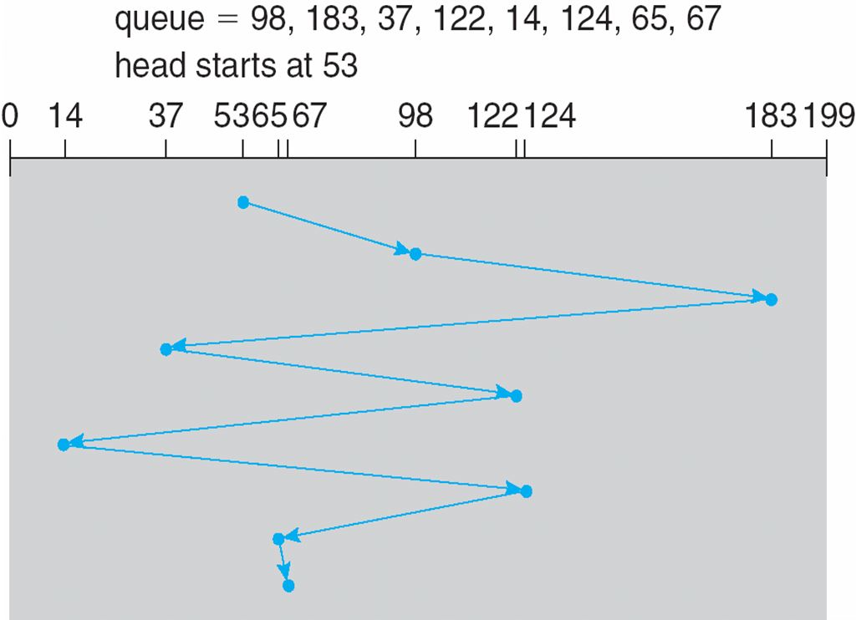
FCFS Scheduling

Slide 8
Disk Scheduling
SCAN Scheduling
The disk arm starts at one end and moves towards the other end, servicing requests as it reaches each cylinder
Direction of head movement reverses after reaching the other end
This is also called the elevator algorithm
Head position is 53 and is moving towards 0
A total of 229 head movements
C-SCAN (Circular SCAN) Scheduling
Designed to provide a more uniform wait time
The head moves from 0 to Max, while servicing the requests

Slide 9
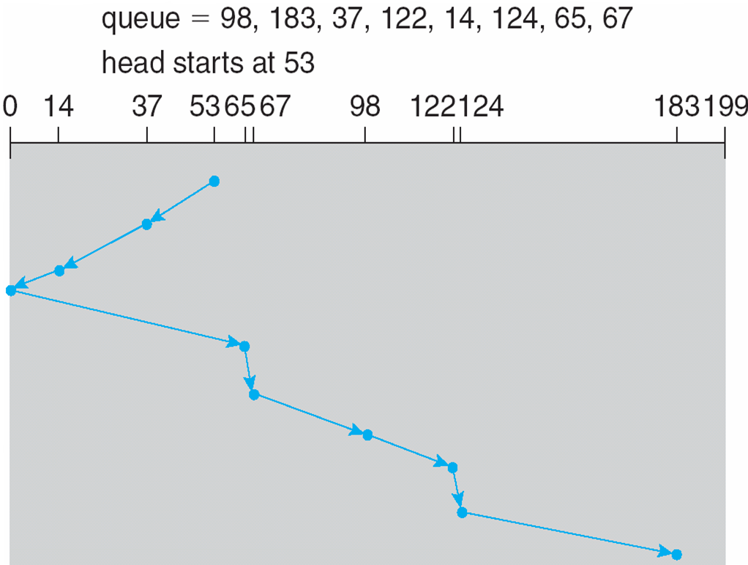
SCAN Scheduling

Slide 10
Disk Scheduling
It immediately returns to the beginning
183 total head movements take place
Many other scheduling algorithms exist
Only the popular ones are discussed
Choice of a disk scheduling algorithm is dependent on a number of factors
Performance depends on the number and types of requests
SCAN and C-SCAN performs better when there is heavy load on the disk
Less likely to cause a starvation problem
Linux uses deadline scheduler that is similar to C-SCAN

Slide 11
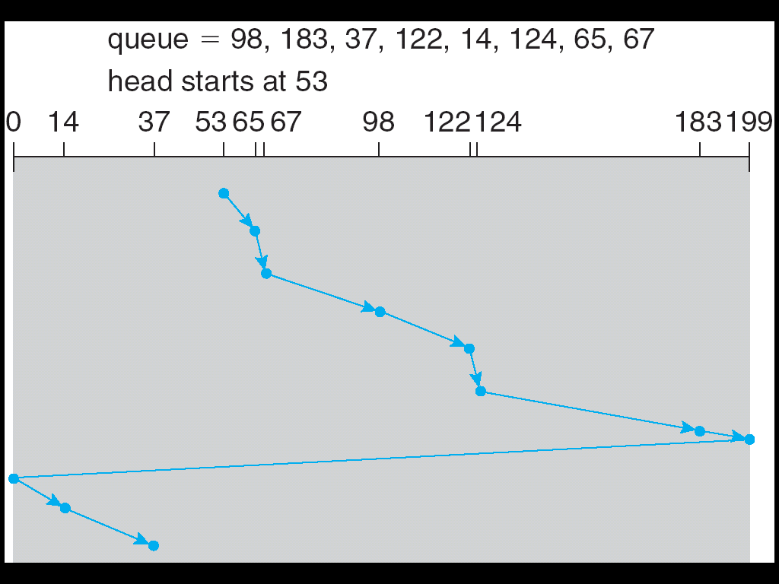
C-SCAN Scheduling

Slide 12
NVM Scheduling
NVM devices do not depend on the disk head movements
Does not contain disk heads
Use simple FCFS policy for scheduling a list of requests
Linux scheduler (NOOP) Modifies to merge adjacent requests
Writing on NVM devices is slower (is also non-uniform) than reading

